Slide 1
Forgiveness in Couple Therapy: Case Studies Addressing Moderate to Major Offenses
Jennifer S. Ripley, Mary “Lexie” Norris

Slide 2
Learning Objectives
Identify basic and clinical research in couple forgiveness that can contribute to clinical settings
Explain case study research of couples with moderate to severe relational offenses including the use of routine outcome monitoring
Address diversity issues in forgiveness interventions with clients, especially implications for various religious traditions

Slide 3
Forgiveness Quiz
If a spouse apologizes for an offense, before being pressured to, forgiveness is easier. Why?
It feels good to see the spouse grovel
If the spouse is not sorry, forgiveness isn’t needed
An apology restores a sense of justice, making it easier to forgive
An apology repairs damage to the relationship
Notes:
Have the group raise fingers with their answer

Slide 4
Forgiveness Quiz
Does forgiveness mean that you at least need to try and restore the relationship to pre-offense status?
Yes, without restoration of the relationship, there is no true forgiveness.
Yes, except for in a few cases in which restoring the relationship is not possible (like an abusive relationship).
No, forgiveness is in the individual; it is separate from relationship restoration, which depends on the other person, too.
No, forgiveness is something God initiates in us; relationship restoration is something within the realm of human effort.

Slide 5
Forgiveness Quiz
How can a spouse forgive, believe she or he was successful at it, and still end up feeling upset about the same offense later?
Forgiveness was only partial, not complete forgiveness.
There are two kinds of forgiveness—a decision to forgive and a change in one’s emotion.
The person was mistaken; he or she wasn’t successful forgiving; if he or she were successful, the unforgiveness would not have returned.
Forgiveness really doesn’t depend on setting one’s mind to forgiving, but is a matter of the work of the Holy Spirit.

Slide 6
What is Forgiveness?
Forgiveness is not
Forbearance
Condoning or Excusing
Reconciling
Forgetting
Justifying
Getting justice
Severity & Frequency of offense matters
Notes:
Open with a story about a couple forgiving something meaningful in therapy. One forgiving something big, the other forgiving something small but super-common

Slide 7
What is forgiveness?
A choice and an emotion.
A motivated choice to not seek revenge, or avoid the offender.
A reduction in negative emotions, replaced with positive emotions and an attitude of goodwill (especially in ongoing relationships)
It is an interpersonal process, although it happens within the skin of the offended person
It is “outward looking” and “other directed”

Slide 8
What is forgiveness?
Two types:
Decisional forgiveness:
  A behavioral intention to refrain from seeking revenge and to treat an offender as a valuable person
Emotional forgiveness:
  is a replacement of negative, unforgiving emotions with positive, other-oriented emotions.
Notes:
Handbook of forgiveness

Slide 9
Forgiveness in Couples
Forgiveness predicts successful marriages
            “forgiveness systems evolved in response to selection pressures for restoring relationships that, on average, boosted lifetime reproductive fitness” (McCullough, Kurzban, & Tabak, 2011).
            Boleyn-Fitzgerald (2002) observed that forgiveness is “arguably the most important virtue for controlling anger”
            Unforgiveness is quite robust in forgiving negative marital quality, forgiveness is fairly robust
Notes:
Important for sex/reproduction, for addressing anger,
Importance of forgiveness in couples therapy?
Transgressions within the marriage may be especially painful when they are seen to violate the sanctity of the marital bond, thus making forgiveness particularly challenging but critical to sustaining the relationship

Slide 10
Forgiveness
Greater commitment is related to greater forgiveness
  Appears to be both directions. Commitment leads to move forgiveness, and more forgiveness leads to more commitment (Tsang, McCullough & Fincham, 2006)
Conflict tactics and Self-regulation have support as mechanisms that link forgiveness to satisfaction ( Braithwait, Selby & Fincham, 2011)
Forgiveness linked to trust, closeness and use of plural pronouns in relationship
Religiosity predicts forgiveness, well a little bit…
Notes:
Commitment is believed to be a major mediator- strong commitment couples in therapy will take risks, which includes forgiveness. This is why low commitment couples are harder to treat – they have one foot out of the relationship, are beginning to consider other options for life/happiness besides this relationship, and don’t want to “throw good money after bad” in their emotional economy
Forgiveness has been similarly linked to other important relationship features such as close-ness (Karremans et al., 2011), trust (Weiselquist, 2009), and couple identity (more use of plural person pronouns in relationship discourse; Karremans & Van Lange, 2008), leaving little doubt that forgiveness likely influences relationship well-being and vice versa.

Slide 11
Forgiveness Intervention- From Scientific Mystery to Empirically Supported Treatment
Penicillin was adopted in the 1940s. But we only begun to figure out WHY it works in the last couple of decades.
Acetaminophen sells ~ 27 billion doses a year. But researchers still have mystery around why it works. Still testing basic hypotheses.
We don’t’ fully understand why forgiveness works in intimate partnerships- but we do know we can intervene.
Two main approaches with dozens of studies on each - REACH (Worthington) and a process model (Enright). Other studies are a few but in the positive direction.
Meta analysis of forgiveness interventions shows moderate effect size for forgiveness, as well as improvements in depression, anxiety and hope (Wade, Hoyt, Kidwell & Worthington, 2014)
We care about forgiveness- nested with other relationship variables
Notes:
The most recent meta-analysis (Wade, Hoyt,
Kidwell, & Worthington, 2014), using 53 post-
treatment effect sizes (for interventions from 1
to 57 hours) involving 2,323 participants who
had received a forgiveness intervention for a
specific hurt, showed not only that participants
displayed greater forgiveness than nonpartici-
pants (Becker’s Δ =0.56) or those who received
an alternative intervention (Becker’s Δ =0.45),
but that they also displayed fewer depressive
(Becker’s Δ =0.34, 10 studies) and anxiety
(Becker’s Δ =0.63, seven studies) symptoms
as well as greater hope (Becker’s Δ =1.00,
six studies). Although the effect sizes did not
statistically differ from those obtained for
forgiveness, the effects of the intervention
for reducing reported depressive and anxiety
symptoms were 40% to 50% lower than for
forgiveness.

Slide 12

REACH Model of Forgiveness
R- Recall the hurt
E- Empathize with the one who hurt you
A- Altruistic gift of forgiveness
C- Commit to forgive
H- Hold onto forgiveness during doubts
Notes:
REACH model - our main forgiveness intervention in the HOPE clinic

Slide 13

Effectiveness of the Hope-Focused REACH Model
Meta-analysis results indicate moderate to strong effects for helping participants
However, it has been found that more time spent on REACH interventions predicts greater forgiveness
Majority of research has been focused on “regular” relationship offenses
The end-goal of couple therapy is not just forgiveness- but reconciliation, restoration of trust, ultimately the restoration of the bond between the partners
But for the majority of couples forgiveness is a necessary STEP in the process

Slide 14
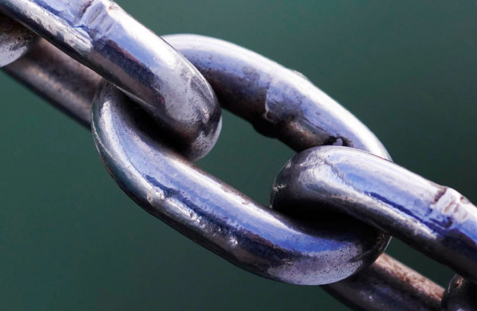
Our model and case studies
Ultimate goal: Improve the Relational Bond through Hope-focused strategic interventions that are positive, memorable, active, and engaging for the couple.
We spend time with their pain, and understand and empathize with the pain.
But given that the pain-giver is in the room, it’s important to focus on moving forward as a couple to re-bond. Shaming each other as pain-givers isn’t a productive use of their time in treatment.

Slide 15
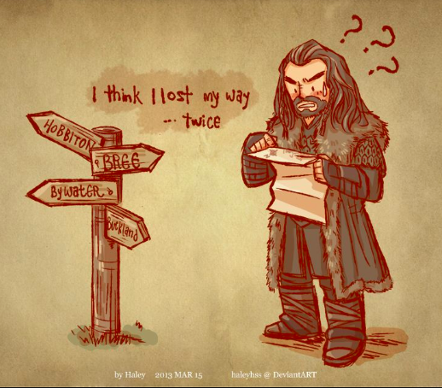
The big picture
Ultimate Goal is BOND
Steps to treatment
1. De-escalate immediate painful conflict
Turn towards each other. (roll to the middle)
Move forward together
Notes:
If needed review that the BOND is where all the research has pointed as the ultimate goal- so not to lose sight of the ultimate goal when doing the steps towards the goal.
These are trans-theoretical goals of couple therapy, regardless of theory influence. The picture is a hobbit losing their way on one of the grand journeys/quests. Losing their way is kind of the hobbit way of things- always losing their way. Of course that might be the human way too- Israelites, dessert…

Slide 16
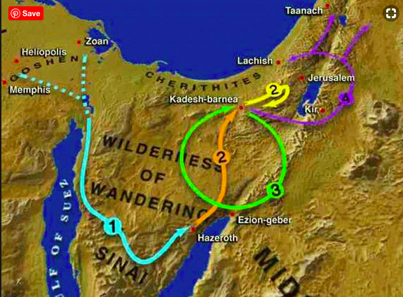
Wandering in the desert = couple therapy?

Slide 17
Strategy through the Desert…
1. De-escalate immediate painful conflict
Positive- date night, positive active responding, gratitude
Reduce negative- time out, soft start up, insight-building if needed
2. Turn towards each other
Positive- TANGO communication, reattributions, psychological needs card sort
Reduce negative- LOVE, Sculpting intimacy, distancer- pursuer patterns
Move forward together
Forbearance, Grace, Stop ruminations, restitution, REACH forgiveness, forgive self, build humility, Deal with reinjury, triggers
Notes:
These are example interventions that could help with each stage of treatment. Can work on all of them at once though… but keep an eye on where the clients are in the process.
Can use a space metaphor to communicate idea.
1. Stop causing pain (stop pushing each other)
2. Look at each other- turn towards
3. Join hands again and journey together again
Or Stop- Look- Walk

Slide 18
Case #1-
Tom and Cassandra
Bond interventions: date night, gratitude journal
Turn towards each other: sculpting, empty chair
Move forward: REACH (individual and then in relationship), Joshua memorial
Notes:
Don’t forget routine outcome monitoring… we promised we would cover that
Set the stage- several instances of hurt. Some emotional infidelity. Definitely painful offenses (some of which were long-term and on-going, for example sliding into the decision to not have children.
REACH- they did the model individually during a break in therapy (due to school closure)- both of them happened to work towards forgiving a family member who had hurt their spouse- already a sign that they were ready to turn towards each other.
Sculpting/ empty chair- experiential interventions that allowed each partner to empathize with the pain of the other. Both reported in their six month follow up that these were the most memorable interventions.
RDAS scores and GRACE scores both improved, especially in the areas of forgiveness, intimacy and closeness, and optimism and Hope
Joshua memorial: made pots for each other to plant trees in the back yard (used a hedgehog as a metaphor to encourage vulnerability) – incorporated the hedgehog in the memorial
Overall, a long case. Had to process a lot of pain and do so slowly

Slide 19
Case #2
Steven and Catherine
Bond interventions: time-out, date night, gratitude
Turn towards each other: TANGO/communication, sculpting, distancer-pursuer
Move forward: grace, REACH (highlight on two components of forgiveness), triggers
Notes:
More cases as needed
Difficulty with consistent smaller offenses- (i.e. chores, parenting choices, intimacy, etc.)
Improvement on outcome measures
Increased capacity to handle distress and engage in decisional forgiveness, followed by emotional forgiveness
Overall, increased bond*

Slide 20

Implications of Religion in Forgiving Couples
High value- also increases possibility of desecration of the sacred. “you not only offended me with your online “trist” you offended God and all things holy
God abandoned me (due to my or partner’s sin), no longer blessed
Some people are justice-oriented in religion and have a very difficult time with compassion/warm virtues of forgiveness

Slide 21
Forgiveness Quiz
If a spouse apologizes for an offense, before being pressured to, forgiveness is easier. Why?
It feels good to see the spouse grovel
If the spouse is not sorry, forgiveness isn’t needed
An apology restores a sense of justice, making it easier to forgive
An apology repairs damage to the relationship
Notes:
Giving answers as we close

Slide 22
Forgiveness Quiz
Does forgiveness mean that you at least need to try and restore the relationship to pre-offense status?
Yes, without restoration of the relationship, there is no true forgiveness.
Yes, except for in a few cases in which restoring the relationship is not possible (like an abusive relationship).
No, forgiveness is in the individual; it is separate from relationship restoration, which depends on the other person, too.
No, forgiveness is something God initiates in us; relationship restoration is something within the realm of human effort.

Slide 23
Forgiveness Quiz
How can a spouse forgive, believe she or he was successful at it, and still end up feeling upset about the same offense later?
Forgiveness was only partial, not complete forgiveness.
There are two kinds of forgiveness—a decision to forgive and a change in one’s emotion.
The person was mistaken; he or she wasn’t successful forgiving; if he or she were successful, the unforgiveness would not have returned.
Forgiveness really doesn’t depend on setting one’s mind to forgiving, but is a matter of the work of the Holy Spirit.

